Slide 1
Advanced Web programming
Lec-26
Unit 3
Styles, Themes, and Master Pages

Slide 2
Outline
Styles, Themes, and Master Pages :
Styles,
Themes,
Master Page Basics,
Advanced Master Pages,

Slide 3
WAP to count the number of active visitors on your ASP.NET web site.
https://www.c-sharpcorner.com/UploadFile/cd3aa3/7526/
HOW TO COUNT NUMBER OF TIMES WEBSITE VISITED AND ONLINE USERS IN ASP.NET USING C#
https://www.webcodeexpert.com/2013/10/how-to-count-number-of-times-website.html

Slide 4
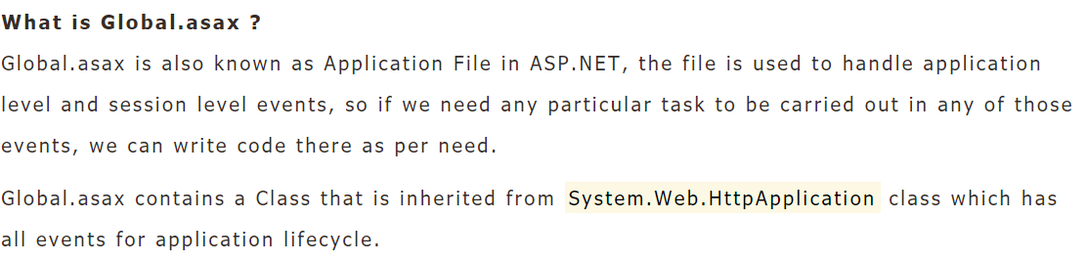
Global.asax file

Slide 5
Application State is a state management technique.
Application State is stored in the memory of the the server and is faster than storing and retrieving information in a database.
Session sate is specific for a single user session, but Application State is for all users and sessions.
Application State does not have a default expiration period. When we close the worker process the application object will be lost.
Technically the data is shared amongst users by a HTTPApplcationState class and the data can be stored here in a key/value pair.
It can also be accessed using the application property of the HTTPContext class.
https://www.c-sharpcorner.com/UploadFile/225740/application-state-in-Asp-Net/

Slide 6
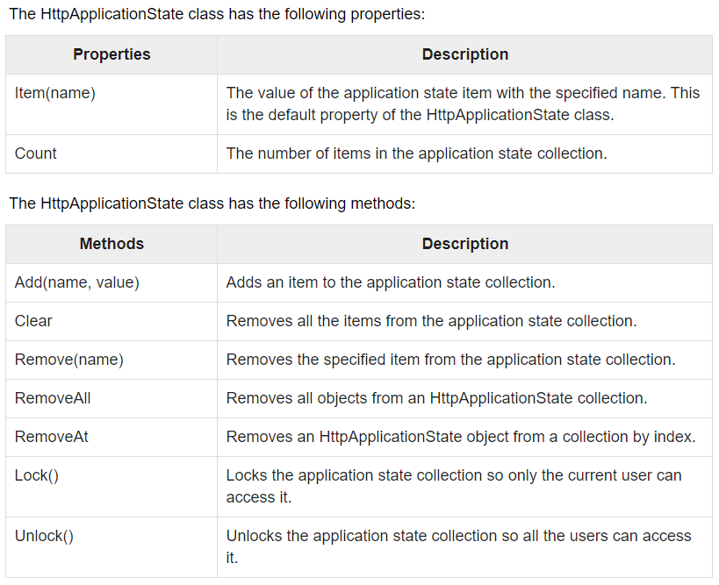

Slide 7
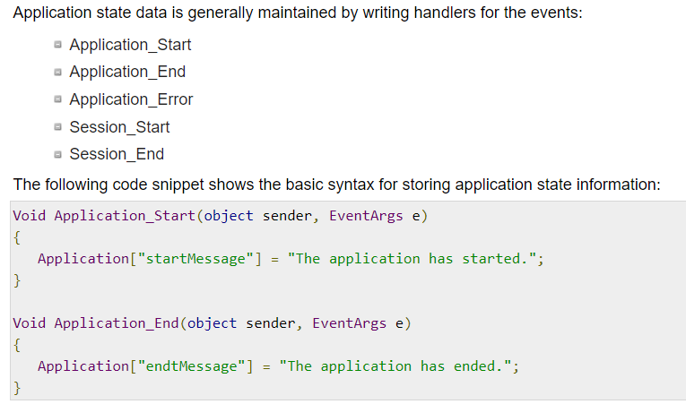

Slide 8
How to use Query String and session state-
https://www.msdotnet.co.in/2013/10/how-to-use-query-string-in-aspnet.html#.X42LodAzZPY
https://www.msdotnet.co.in/2013/10/how-to-use-session-state-in-aspnet.html#.X42K09AzZPY
HOW TO COUNT NUMBER OF TIMES WEBSITE VISITED AND ONLINE USERS IN ASP.NET USING C#
To count the number of active visitors on your ASP.NET web site.-
https://www.c-sharpcorner.com/UploadFile/cd3aa3/7526/
https://www.aspdotnet-suresh.com/2013/11/asp-net-count-number-of-visitors-in-Website.html
https://www.webcodeexpert.com/2013/10/how-to-count-number-of-times-website.html

Slide 9
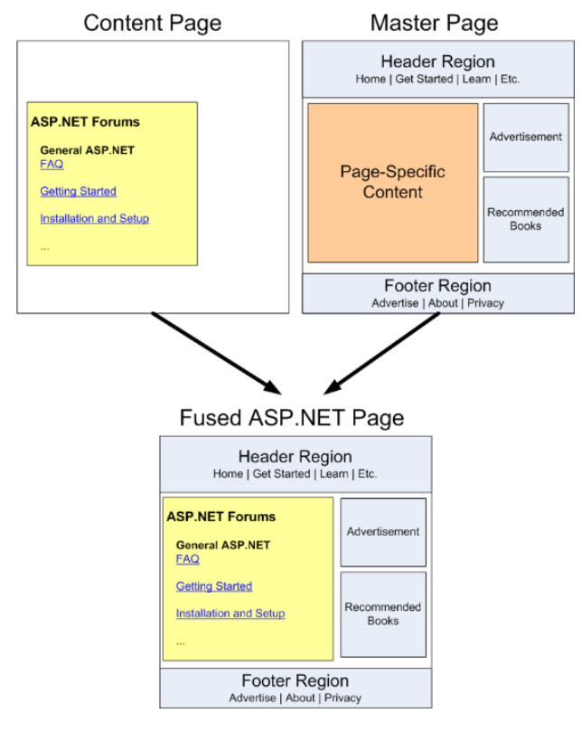

Slide 10
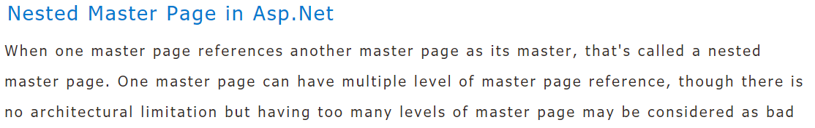
Nested master page
https://www.c-sharpcorner.com/uploadfile/kalisk/nested-master-pages-in-Asp-Net-3-5/
https://www.c-sharpcorner.com/UploadFile/abhikumarvatsa/creating-master-page-masterpage-in-web-config-in-Asp-Net/

Slide 11
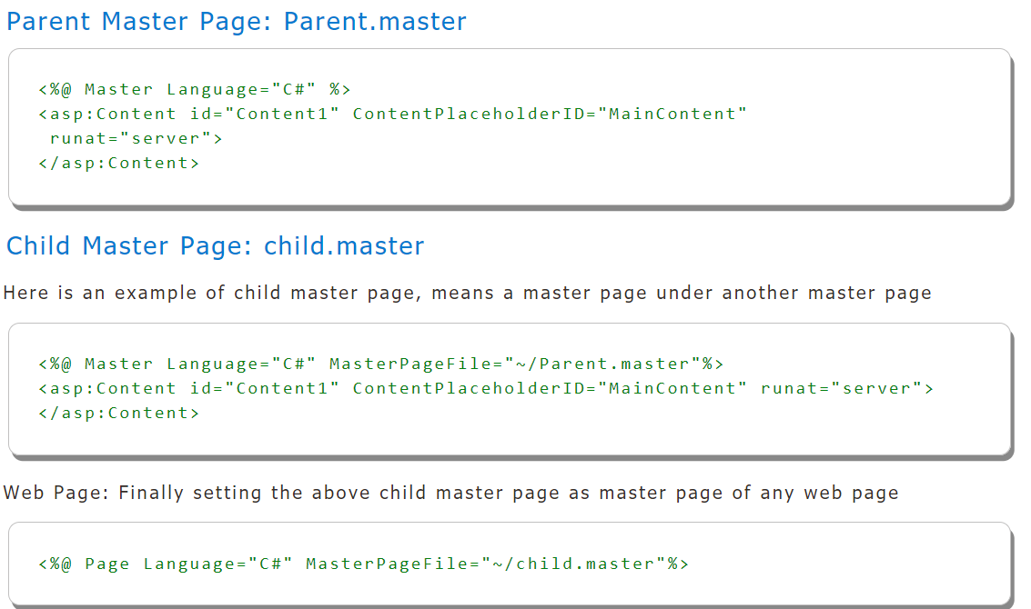

Slide 12
https://www.c-sharpcorner.com/article/how-to-create-master-page-in-asp-net/
https://practiceaspnet.wordpress.com/2015/09/18/master-pages-in-asp-net/

Slide 13
To be continued….

Slide 14
Lec (26/10/20) quiz

